Slide 1
ENGR-304-L
Software Lab 03

Slide 2
Agenda
Attendance
Recap
Functions & Recursion
Functions in Assembly
The Stack
Getting Started

Slide 3
Recap
Assembly programming language is closely related to machine code
NIOS CPU executes machine code while running program
Program results can be found in registers or memory
Compiler optimization can be a useful tool

Slide 4
Functions
Functions defined by behavior, inputs, & outputs
Function
Behavior
Function
Inputs
Function
Outputs

Slide 5
Functions
Functions defined by behavior, inputs, & outputs
Often referred to as definition, parameters, return values
Function
Definition
Function
Parameters
Function
Return Values

Slide 6
Recursion
Recursive problems can be divided into sub-problems
The recursive solution is identical for the original problem and the sub-problems
There must be at least 1 base-case defining a “smallest” sub-problem with a non-recursive solution
Ex: Fibonacci
Fibonacci(n) = Fibonacci(n-1) + Fibonacci(n-2) // n > 1
Fibonacci(n) = n // 0 <= n <= 1

Slide 7
Recursion
Fib(n) = Fib(n-1) + Fib(n-2) // n > 1
Fib(n) = n // 0 <= n <= 1
Problem is solved by sub-problems

Slide 8
Recursion
Fib(n) = Fib(n-1) + Fib(n-2) // n > 1
Fib(n) = n // 0 <= n <= 1
Problem is solved by sub-problems
There are 2 base-cases

Slide 9
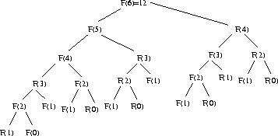
Recursion
Fib(n) = Fib(n-1) + Fib(n-2) // n > 1
Fib(n) = n // 0 <= n <= 1
Problem is solved by sub-problems
There are 2 base-cases
https://www8.cs.umu.se/kurser/TDBA77/VT06/algorithms/BOOK/BOOK25/IMG313.GIF

Slide 10
Recursive Functions
Recursive functions call themselves as sub-problems
Function Definition
Base-Case Return Values
(if base-case)
Check For Base-Case
Outer Function
Parameters
Outer Function
Return Values
Function
Definition
(same as outer)
Inner Function
Parameters
(if not base-case)
Inner Function
Return Values

Slide 11
Recursive Functions
C Function Declarations
Parameter list
Return type
First parameter type
Function name
First parameter name

Slide 12
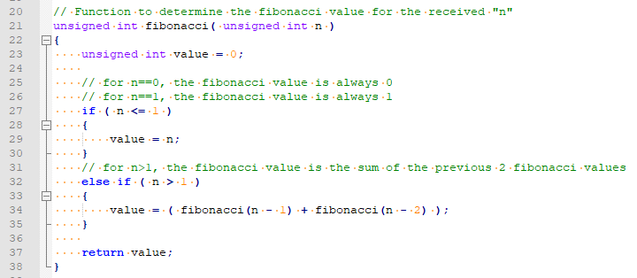
Recursive Functions
C Function Definitions
Local variables
Recursive base-case check
Return statement
Recursive function calls

Slide 13
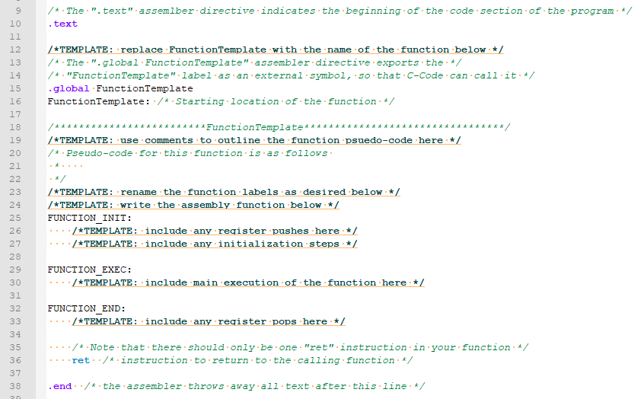
Assembly Functions
Global label for
function name
“call”
“ret”

Slide 14
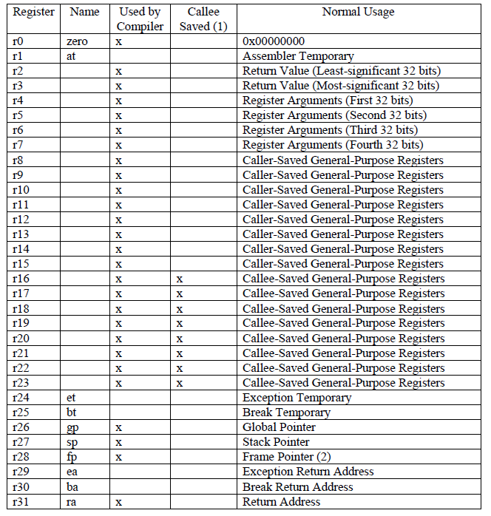
NIOS Function Registers
Standard register usage “agreement”
R2, R3 – return value
R4, R5, R6, R7 – parameters
RA (R31) – return address
Callee-saved vs Caller-saved

Slide 15
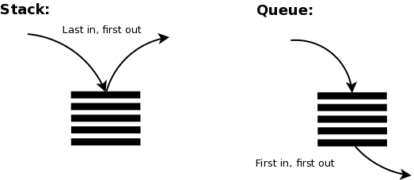
The Stack
Stacks & Queues
Ex: buffet dishes & amusement park lines
https://cdn-images-1.medium.com/max/523/1*asgh4mx9ez5Ji8PmBayS8g.png

Slide 16
The Stack
Stacks & Queues
Ex: buffet dishes & amusement park lines
Stack Push & Pop
Push
Pop
https://cdn-images-1.medium.com/max/523/1*asgh4mx9ez5Ji8PmBayS8g.png

Slide 17
The Stack
Stack is useful for nested function calls (ex: recursion)
Push
Info about 1st function call
https://cdn-images-1.medium.com/max/523/1*asgh4mx9ez5Ji8PmBayS8g.png

Slide 18
The Stack
Stack is useful for nested function calls (ex: recursion)
Push
Info about 2nd function call
Info about 1st function call
https://cdn-images-1.medium.com/max/523/1*asgh4mx9ez5Ji8PmBayS8g.png

Slide 19
The Stack
Stack is useful for nested function calls (ex: recursion)
Push x3
Info about 5th function call
Info about 4th function call
Info about 3rd function call
Info about 2nd function call
Info about 1st function call
https://cdn-images-1.medium.com/max/523/1*asgh4mx9ez5Ji8PmBayS8g.png

Slide 20
The Stack
Stack is useful for nested function calls (ex: recursion)
Pop
Info about 4th function call
Info about 3rd function call
Info about 2nd function call
Info about 1st function call
https://cdn-images-1.medium.com/max/523/1*asgh4mx9ez5Ji8PmBayS8g.png

Slide 21
The Stack
Stack is useful for nested function calls (ex: recursion)
Pop
Info about 3rd function call
Info about 2nd function call
Info about 1st function call
https://cdn-images-1.medium.com/max/523/1*asgh4mx9ez5Ji8PmBayS8g.png

Slide 22
The Stack
Stack is useful for nested function calls (ex: recursion)
Pop x3
<empty>
https://cdn-images-1.medium.com/max/523/1*asgh4mx9ez5Ji8PmBayS8g.png

Slide 23
The Stack
“Info about Xth function call” → preserve state
Even though recursive calls use the
same n parameter and return statement,
the former call should not have its n
changed by the sub-call. We need to
preserve state.

Slide 24
The Stack
“Info about Xth function call” → preserve state
State of registers as used by 3rd function call
State of registers as used by 2nd function call
State of registers as used by 1st function call
https://cdn-images-1.medium.com/max/523/1*asgh4mx9ez5Ji8PmBayS8g.png

Slide 25
The Stack
“Info about Xth function call” → preserve state
Since the stack is in memory,
Push is done by “stw” = add to the top of the stack
Pop is done by “ldw” = remove from the top of the stack
State of registers as used by 3rd function call
State of registers as used by 2nd function call
State of registers as used by 1st function call
https://cdn-images-1.medium.com/max/523/1*asgh4mx9ez5Ji8PmBayS8g.png

Slide 26
The Stack
“Info about Xth function call” → preserve state
Since the stack is in memory,
Push is done by “stw” = add to the top of the stack
Pop is done by “ldw” = remove from the top of the stack
R# as used by 2nd unction call
R# as used by 1st function call
R# as used by 1st function call
The registers all share the same stack, may be several for
each function call (arbitrarily showing 2 for 1st and 1 for 2nd)
https://cdn-images-1.medium.com/max/523/1*asgh4mx9ez5Ji8PmBayS8g.png

Slide 27
The Stack
“Info about Xth function call” → preserve state
Since the stack is in memory,
Push is done by “stw” = add to the top of the stack
Pop is done by “ldw” = remove from the top of the stack
R27 (sp) is the stack pointer, it points to the top of the stack
(1 byte beyond the last used memory address)
sp
Start of last
used block
State of a register on stack
State of a register on stack
Base of
stack
State of a register on stack
https://cdn-images-1.medium.com/max/523/1*asgh4mx9ez5Ji8PmBayS8g.png

Slide 28
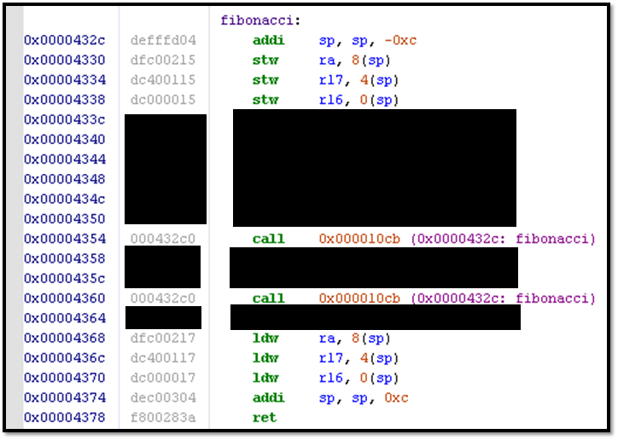
The Stack
Pushing onto stack, note sp decremented
because stack memory goes from end to
start (stack & heap work towards each other)
These calls continue to use and change the stack,
but each pops it back to the state it was in
originally before returning so the caller doesn’t
notice the changes (state preserved)
Popping from stack, note sp has same value
in the end as it did originally
Note: comments removed for slides, always use good comments in assembly, portions of function are redacted

Slide 29
Lab SW03 Tips
Use only the n=0 recursive base case for Factorial program
Use optimization level –O1
Refer to the NIOS summary reference “registers table”
Refer to “NIOS Processor Stack” slide deck for details on assembly functions & stack usage

Slide 30
Getting Started
Setup project directory for SW03 on the H: drive
Download SW03 files from Moodle or S: drive
Also locate the reference files from SW01 & SW02
Start following directions in the lab assignment document

Slide 31
Reference Diagrams
The remaining slides explain certain file types and compilation processes that will apply throughout the semester

Slide 32
Altera DE2 Board
Windows 10 PC
Quartus
FGPA
Peripheral Devices
(Ex: switches, buttons, hex displays)
NIOS Processor Image
NIOS Processor Image
(Flashed)
Switches
Keys
Software (Executing)
Altera DM
LEDs
NIOS Processor Image
7Seg Displays
Timer
Software (Loading/Debugging)

Slide 33
C Code
“portable” C-Code
Compiling
Assembly Code
Compiler-Generated for NIOS: view in debugger, depends on optimization
Assembling
Machine Code
Compiler-Generated for NIOS: view in memory, determine from reference
Loading
NIOS Processor Image
Loading
A system configuration for this FPGA component has been generated, it executes our program and can be viewed by the debugger
Flashed
We are using these in Engr304 Lab
NIOS Processor Hardware
Altera DE2 FPGA Hardware
We don’t have these in Engr304 Lab

Slide 34
C Code is fairly platform-agnostic and can be run on a variety of difference processors, each with their own assembly instruction sets. C Code is compiled into assembly code which is beneficial because the combination of C Code and a compiler has better maintainability, portability, readability, and shorter development times than raw assembly code.
C Code
Compiling
Assembly code is fairly platform-specific and may be shared by families of processors. Assembly code is almost at the level of machine code, but is more readable and maintainable than raw 0’s and 1’s. It is assembled into machine code.
Assembly Code
Assembling
Machine code is the raw 0’s and 1’s that can be interpreted by the processor in order to execute programs. It is rarely used or modified directly since changes to source code occur at the C Code or Assembly Code levels instead. However, it may be captured as an artifact of the build process for a particular program.
Machine Code
Loading
NIOS Processor Image
Loading
Machine code can be loaded onto an image of the processor for which it was assembled and executed therein. In this case, the processor image is the same as a physical processor (for the most part).
Flashed
An FPGA is like “general purpose hardware” which can be flashed with an image of a certain circuit. In this case, the FPGA is flashed with the NIOS Processor Image which allows it to perform essentially like a dedicated NIOS Processor hardware device.
NIOS Processor Hardware
Altera DE2 FPGA Hardware
Machine code can be loaded onto the processor for which it was assembled and “physically” executed therein.

Slide 35
C Code
Compiling
Assembly Code
Assembling
Machine Code
In Lab, the QSys setup helps configure and define what the NIOS Processor Image is.
Loading
NIOS Processor Image
Loading
Machine code can be loaded onto an image of the processor for which it was assembled and executed therein. In this case, the processor image is the same as a physical processor (for the most part).
Flashed
An FPGA is like “general purpose hardware” which can be flashed with an image of a certain circuit. In this case, the FPGA is flashed with the NIOS Processor Image which allows it to perform essentially like a dedicated NIOS Processor hardware device.
NIOS Processor Hardware
Altera DE2 FPGA Hardware

Slide 36
C Code
Compiling
Assembly Code
Assembling
Machine Code
Loading
NIOS Processor Image
Loading
Machine code can be loaded onto an image of the processor for which it was assembled and executed therein. In this case, the processor image is the same as a physical processor (for the most part).
In Lab, the Altera DE2 boards are FPGA’s (+ some peripherals) that we load the image onto.
Flashed
An FPGA is like “general purpose hardware” which can be flashed with an image of a certain circuit. In this case, the FPGA is flashed with the NIOS Processor Image which allows it to perform essentially like a dedicated NIOS Processor hardware device.
NIOS Processor Hardware
Altera DE2 FPGA Hardware

Slide 37
C Code
Compiling
Assembly Code
Assembling
Machine Code
Loading
NIOS Processor Image
Loading
In Lab, part of flashing the FPGA involves compiling a .sof file from a .bdf file. The .bdf holds the NIOS component from QSys and the .sof is specific to the DE2.
Machine code can be loaded onto an image of the processor for which it was assembled and executed therein. In this case, the processor image is the same as a physical processor (for the most part).
Flashed
An FPGA is like “general purpose hardware” which can be flashed with an image of a certain circuit. In this case, the FPGA is flashed with the NIOS Processor Image which allows it to perform essentially like a dedicated NIOS Processor hardware device.
NIOS Processor Hardware
Altera DE2 FPGA Hardware

Slide 38
C Code
In Lab, we write assembly code for the NIOS processor ( the .s file).
Compiling
Assembly code is fairly platform-specific and may be shared by families of processors. Assembly code is almost at the level of machine code, but is more readable and maintainable than raw 0’s and 1’s. It is assembled into machine code.
Assembly Code
Assembling
Machine code is the raw 0’s and 1’s that can be interpreted by the processor in order to execute programs. It is rarely used or modified directly since changes to source code occur at the C Code or Assembly Code levels instead. However, it may be captured as an artifact of the build process for a particular program.
Machine Code
Loading
NIOS Processor Image
Loading
Flashed
Altera DE2 FPGA Hardware
NIOS Processor Hardware

Slide 39
C Code
Compiling
Assembly code is fairly platform-specific and may be shared by families of processors. Assembly code is almost at the level of machine code, but is more readable and maintainable than raw 0’s and 1’s. It is assembled into machine code.
Assembly Code
In Lab, we can use the debug monitor to look into memory and see the machine code assembled based on the assembly code.
Assembling
Machine code is the raw 0’s and 1’s that can be interpreted by the processor in order to execute programs. It is rarely used or modified directly since changes to source code occur at the C Code or Assembly Code levels instead. However, it may be captured as an artifact of the build process for a particular program.
Machine Code
Loading
NIOS Processor Image
Loading
Flashed
Altera DE2 FPGA Hardware
NIOS Processor Hardware

